Slide 1
Identification of Cardiovascular Disease
in ECG Images

Slide 2




Team Details
Pentamalla Hariharan
Tammineni Bhavyasree
College: St.Peter,s Engineering college
Stream: CSE
Year of graduation:2024
College:St.Peters Engineering college
Stream: CSE
Year of graduation:2024
K.Shanmukh
College:St.Peter's Engineering College
Stream: CSE
Year of graduation:2024
Under the Guidance of :
Dr.V.Vaitheeshwaran
Assosiate professor

Slide 3
Theme
The theme of the project revolves around leveraging modern technology, particularly machine learning and image processing techniques, to advance cardiovascular disease (CVD) diagnosis and prediction using electrocardiography (ECG) images. The innovative aspect lies in the integration of computer vision and machine learning algorithms with traditional medical diagnostics, offering a novel approach to detecting CVDs.
Innovate For Society
Apply technology in innovative ways to help way we work and live, and create value for our society

Slide 4
ABSTRACT
The project aims to predict cardiovascular disease using electrocardiogram (ECG) images through machine learning. ECG images, collected from various sources, undergo preprocessing steps like grayscale conversion, resizing, and division into 12 leads. Features are then extracted from the images using contour tracing, followed by scaling for consistency. The data is structured into CSV files, combining lead signals with disease labels.
A web application allows users to upload ECG images for analysis. A pretrained machine learning model is employed, trained on labeled ECG datasets. Ensemble techniques are utilized for model enhancement. Performance evaluation metrics like accuracy, precision, and recall are used to assess the model's effectiveness. The project concludes by analyzing results and suggesting future improvements, aiming to enhance cardiovascular disease prediction from ECG images for early detection and intervention.

Slide 5
PROBLEM STATEMENT
The problem is that cardiovascular diseases (CVDs) are a major cause of health issues and mortality globally. Early detection of these diseases is crucial for timely intervention and treatment. However, diagnosing cardiovascular diseases from electrocardiogram (ECG) images can be challenging and time-consuming for healthcare professionals.
To address this problem, we aim to develop a system that uses machine learning techniques to analyze ECG images and predict the presence of cardiovascular diseases accurately.

Slide 6
Existing System
Identification of cardiovascular disease (CVD) in electrocardiogram (ECG) images, diagnosis relied heavily on visual interpretation by trained medical professionals. This process involved examining paper printouts of ECG tracings, which were produced by the ECG machine, and analyzing various waveform patterns and intervals.
Here's an overview of the traditional process:
Recording ECGs
Printing ECG Tracings
Visual Analysis
Manual Measurement
Interpretation and Diagnosis

Slide 7
DISADVANTAGES FOR EXISTING SYSTEM
Subjectivity and Variability
Time-Consuming
Limited Accessibility to Expertise
Risk of Human Error
Dependence on Training and Experience
Inability to Handle Large Volumes

Slide 8
Proposed solution
Proposed solution involves developing a system that uses machine learning to analyze ECG images and predict cardiovascular diseases. ECG images will be preprocessed to enhance clarity, then divided into sections for feature extraction. Key features will be extracted using advanced techniques, and a machine learning model will be trained on these features. The model will be deployed through a user-friendly web application, allowing users to upload ECG images for analysis. By automating the analysis process, our system aims to provide healthcare professionals with a reliable tool for early detection and intervention in cardiovascular diseases.

Slide 9
Advantages of Proposed Solution with Existing
Automation: Modern processes utilize computer algorithms and machine learning to automate certain aspects of ECG analysis, reducing the need for manual interpretation.
Efficiency: With automated analysis, the modern process can analyze ECGs more quickly than the traditional manual process, leading to faster diagnosis and treatment.
Consistency: Computer algorithms provide consistent and standardized analysis, reducing variability in interpretation compared to human observers.
Scalability: Modern processes can handle large volumes of ECG data more effectively, making them suitable for high-throughput environments such as hospitals and clinics.
Advanced Analytics: Machine learning algorithms can identify subtle patterns and associations in ECG data that may not be readily apparent to human observers, potentially improving diagnostic accuracy.

Slide 10
ALGORITHMS USED
1.K-NEAREST NEIGHBOUR (KNN)
2.CONVOLUTION NEURAL NETWORKS (CNN)

Slide 11
REQUIREMENTS
HARDWARE REQUIREMENTS :
Operating System : Any OS
Processor : i5 and above
Ram: 8GB and above
Hard Disk: 25 GB in local drive
Software Requirements:
Programming Languages: Python
Libraries and Frameworks: OpenCV (for image preprocessing), scikit-learn (for machine learning model development and evaluation), NumPy, Pandas (for data manipulation and analysis)
IDE (Integrated Development Environment) : VsCode

Slide 12
MODULES
Data Acquisition Module:
This module is responsible for collecting ECG images from various sources such as medical databases or research repositories.
Data Preprocessing Module:
Conversion to grayscale
Resizing
Division into 12 sections
Gridline removal
Conversion to binary images

Slide 13
Feature Extraction Module:
Contour technique for signal extraction
Conversion of waveform to one-dimensional signal
Data Engineering Module:
Scaling of signal values
CSV file creation for storing lead signal values and corresponding target labels
Model Development Module:
Training of machine learning models (e.g., decision trees, random forests, SVM, neural networks)
Ensemble technique implementation for model stacking

Slide 14
Web Application Interface Module:
User-friendly interface for uploading ECG images
Integration with the preprocessing and model deployment modules
Model Deployment Module:
Deployment of the trained machine learning model for real-time prediction
Integration with the web application interface for seamless user experience
Evaluation and Results Module:
Performance evaluation of the machine learning models using metrics like accuracy, precision, recall, and F1-score
Presentation of results to stakeholders

Slide 15
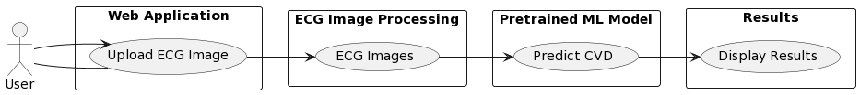
USECASE DIAGRAM

Slide 16
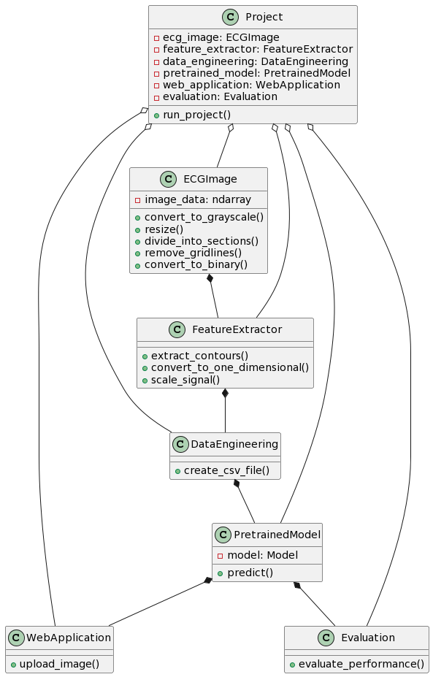
CLASS DIAGRAM

Slide 17
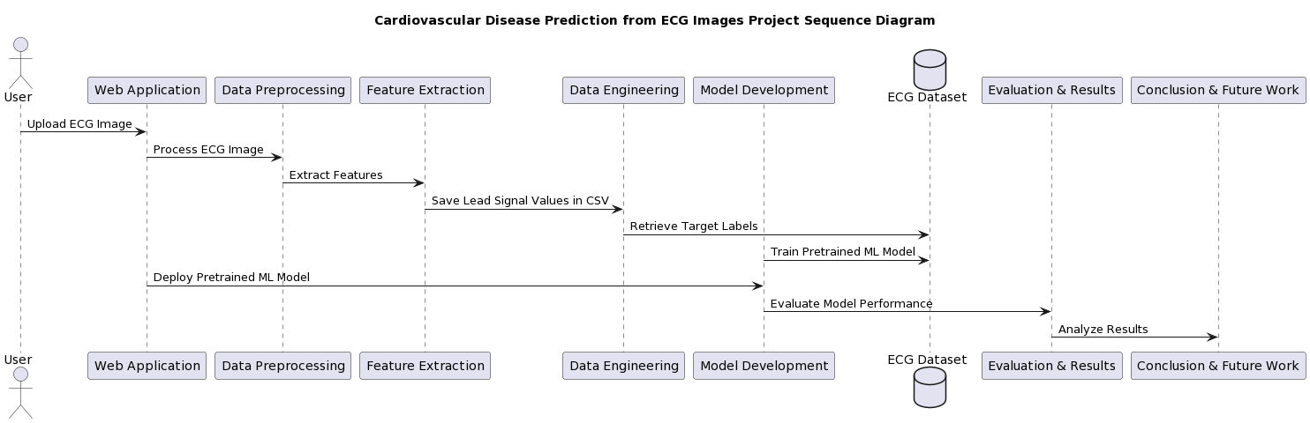
SEQUENCE DIAGRAM

Slide 18
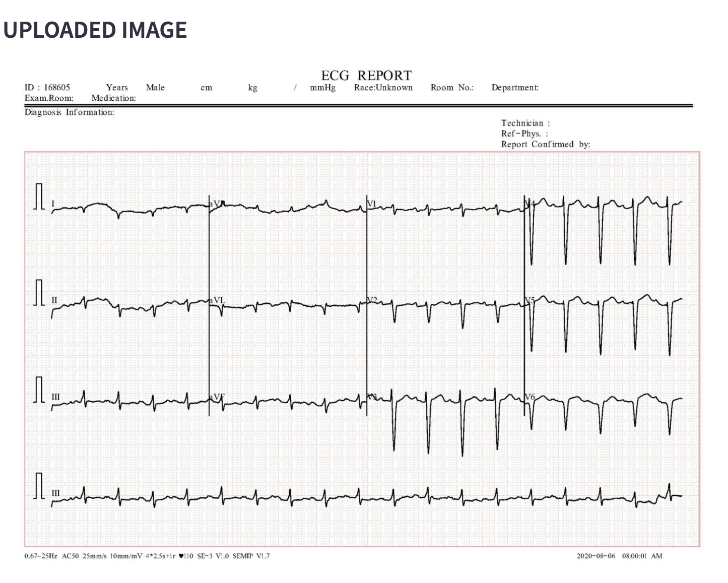
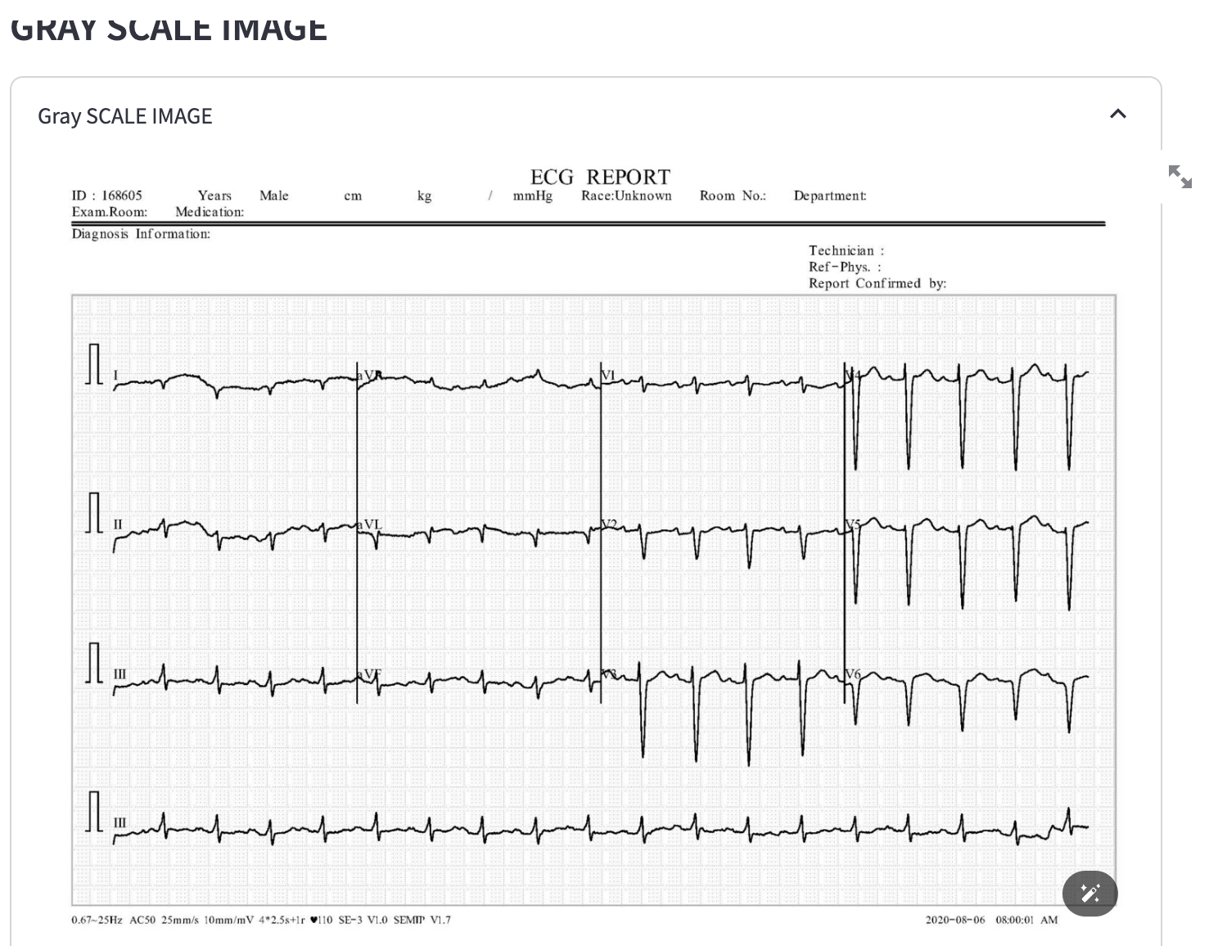
RESULT

Slide 19
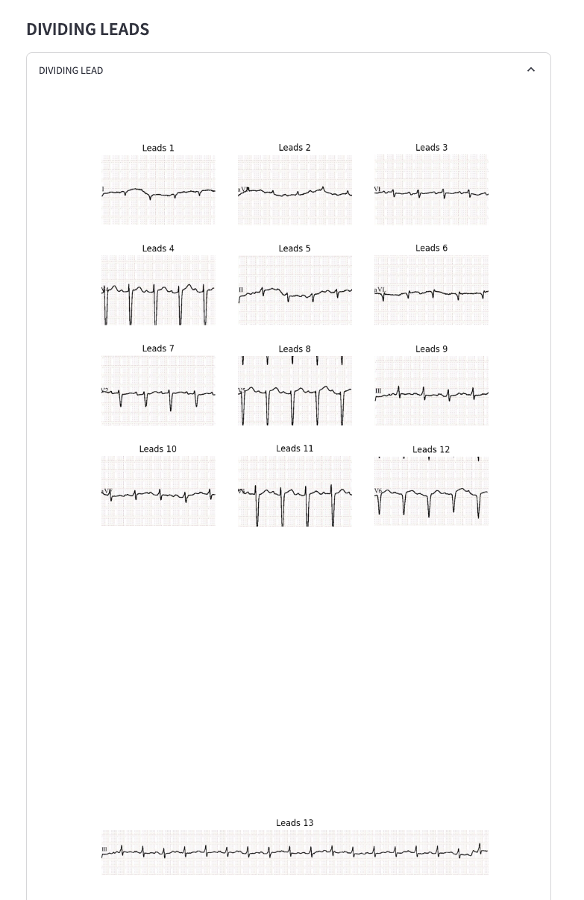
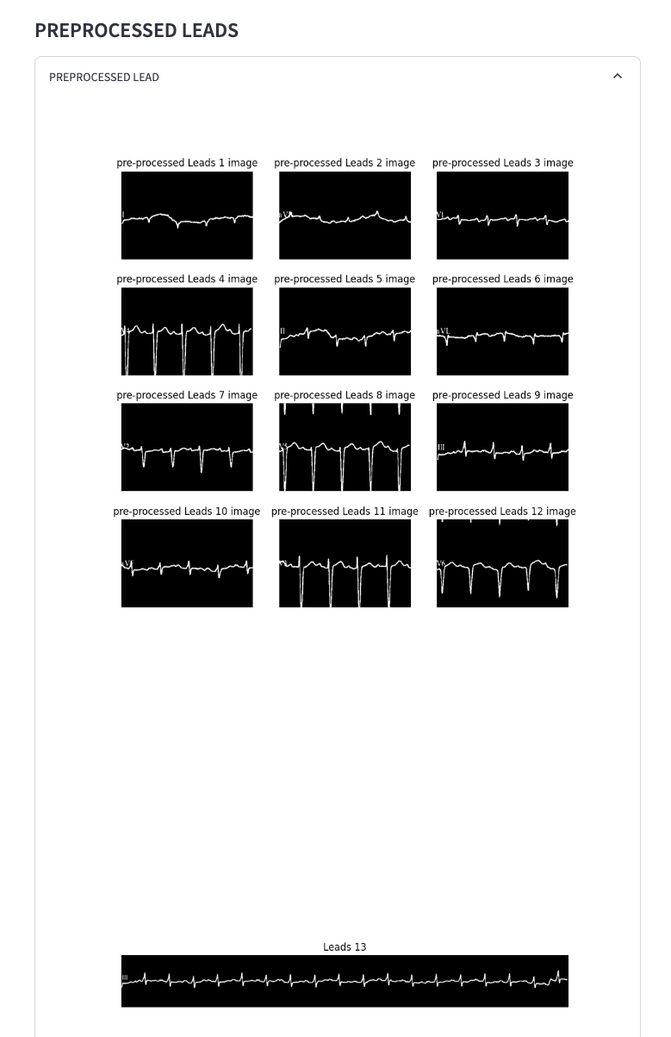
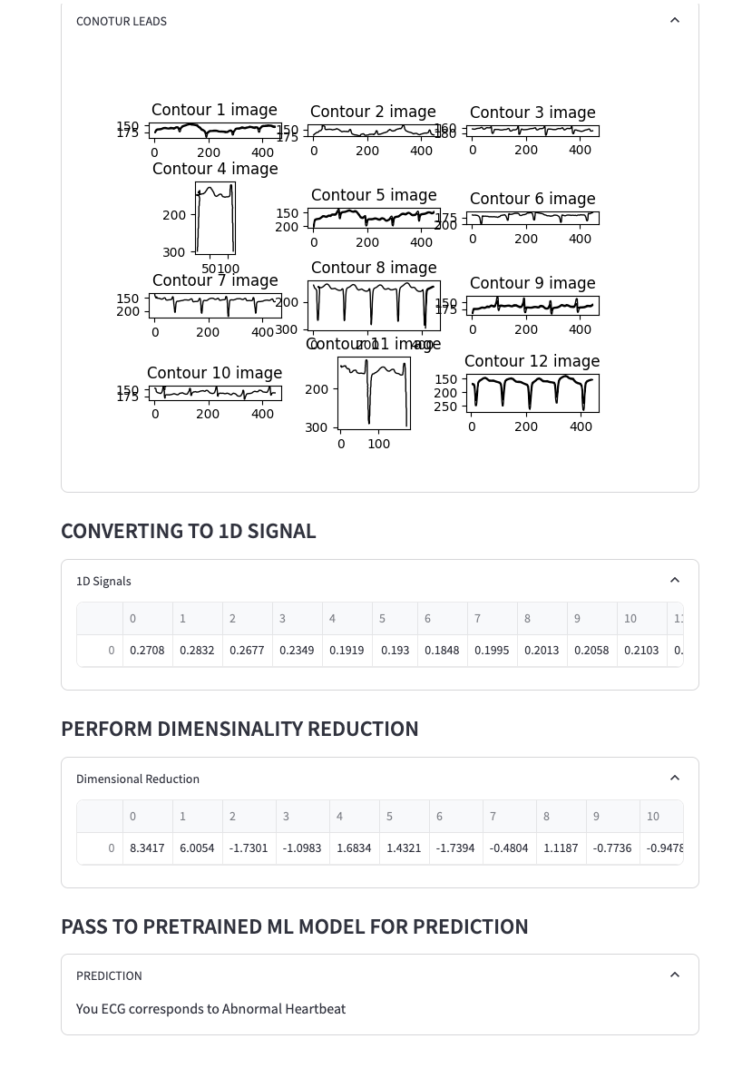
RESULT

Slide 20

Queries?

Slide 21


